Slide 1
Redeployment Process Guidance for Recruiting Managers and Supervisors (receiving a redeployee for a trial)
People Centred
Positive
Compassion
Excellence

Slide 2
Steps
Understanding what Redeployment is
HR role in the process
Line management responsibility
The process
People Centred
Positive
Compassion
Excellence

Slide 3
1. What is Redeployment?
The placement of displaced staff into suitable alternative employment in the quickest possible time and to mitigate the need for redundancies and for dismissal on the grounds of capability.
People Centred
Positive
Compassion
Excellence
Notes:
This is the key to redeployment. It is all about finding staff who have been displaced from their current role and finding them a suitable alternative position in the organisation, thereby mitigating the need to make them redundant.
If you think about it logically, why would we let someone leave the organisation, that we have more than likely invested in, who more than likely has the skills and experience to move to another part of the organisation that is short of manpower?

Slide 4
When do you implement the process
Organisational Change
Capability / Performance Management
Capability / Ill Health
Each have individual Policies that MUST be followed
People Centred
Positive
Compassion
Excellence
Notes:
Organisational Change – In the current climate, the organisation is being asked to look at alternative work models and equipment and become more lean. Funding from CCG also has a major impact on the service we provide.
Performance Management – You would use this as a supportive tool, ultimately staff who are no longer able to fulfil their current role may be required to be placed on redeployment.
Ill Health – Again, staff whose health has deteriorated which has impacted on them being able to fulfil their current role
Please note that there are individual policies for each of these elements, with processes to follow
It is important to understand that each of the processes mentioned, do have their own individual policy and process that MUST be followed, but ultimately link to the redeployment process.

Slide 5
How do we make it successful?
There are 4 prongs to a successful redeployment:
Who | How
Exporting/Line Manager | Supportive to Individual
Recruiting Manager | Supportive to redeployees
HR | Support to individuals and Managers and ensuring a fair and robust process
Individual Employee | Proactive ownership of their own future
People Centred
Positive
Compassion
Excellence
Notes:
This is self-explanatory, but relies heavily on all four elements working together. If one element of this does not wholeheartedly support the process, then it isn’t going to work!
Line Manager – Perception that once on redeployment that it is no longer their responsibility
(In some circumstances e.g. Grievance against Line Manager, it may be necessary to allocate an alternative manager to support/manage the individual through this process)
Recruiting Manager – Need to ensure robust induction plan, 1 to 1 weekly meetings and training
HR – Perception is that it is ultimately our role to support all parties through a fair and robust process
Individual – They do not always take ownership as they are in a negative place “Why Me?”, “Why Should I?” but they do have responsibility to actively engage and be proactive

Slide 6
2. HR Role in the Process
Maintain an up to date Redeployment Register
Make exporting managers and employees aware of suitable vacancies
Ensure redeployees are given first priority for any vacancies
Provide relevant support to candidates in the use of NHS Jobs
Confirm offers of suitable work trials and successful redeployment
Support managers throughout and keep them fully briefed
People Centred
Positive
Compassion
Excellence
Notes:
HR are the link between all parties in this process and are there to support not only Managers, but the individual or individuals at risk. They will:
Maintaining an up to date Trust Redeployment or ‘At Risk’ Register (Redeployment Register)
Making employees on the Redeployment Register aware of suitable vacancies, where requested advising on interview preparation and arranging preferential interviews / matching meetings as appropriate
Ensuring that those on the Redeployment Register are given first priority for advertised jobs (See Section 3.2)
Where requested, providing relevant support to candidates in the use of NHS Jobs and in completing applications (Recruitment Dept.)
Confirming offers of suitable work trials and redeployment
Discussing with the Substantive Manager or Exporting Manager at the end of the redeployment period if no suitable posts have been found and what, if any, posts have been identified as suitable during the process and the actions taken

Slide 7
3. Recruiting Manager Responsibility
The Recruiting Manager will:
Give Priority for interviews to redeployees
Confirm to HR when a trial period has been completed successfully
Set realistic objectives
Provide written evidence of the objectives (successful OR unsuccessful)
People Centred
Positive
Compassion
Excellence
Notes:
The Recruiting Manager has an equally important part to play in this process and as such, they must:
• Give employees on the Redeployment Register priority for interviews / matching meetings and appoint the candidate unless there are criteria that they do not meet.
• Set realistic objectives that are achievable and measurable
Confirm to their HR representative when a trial period has been completed successfully
• Provide written evidence of the objectives set, this must include reasons why an individual was successful or not, following either a review of their application, a matching meeting, or the appropriate trial period. At the application review and/or interview stage, this should be in the format of precisely which criteria on the person specification the candidate did not meet. (Template available)
Please remember, you have to be objective and impartial in this process – If you reject someone, your reasons have to be able to withstand scrutiny at an Employment Tribunal, as that is where it could end up if this process isn’t followed correctly!

Slide 8
4. The Principles of the Process
The responsibility for ensuring successful redeployment rests with all parties.
Costs - e.g. pay protection, new training etc. will be borne by the Exporting department
Suitable alternative vacancies - preferential interview status to the candidate
Redeployee will be granted a minimum of a 4 week work trial period.
Ill Health / Disability - Managers should take into account any reasonable adjustments.
Re-Organisational Change – Redeployees will be expected to make themselves available for any short term or temporary posts.
Forfeiture of rights to redundancy pay or pay protection
People Centred
Positive
Compassion
Excellence
Notes:
Key to a successful redeployment is that the responsibility for ensuring successful redeployment rests with all parties. I cannot stress how important collaboration by all involved is to making this a success. To support this, a set of robust principles have been agreed:
• Any additional costs arising from the redeployment e.g. pay protection, new training etc. will be borne by the Exporting department
• Full financial responsibility for the displaced member of staff will rest with the Exporting department until successful redeployment
• Departments with suitable alternative vacancies for which the individual is qualified will be required to give preferential interview status to the candidate
• Staff will be granted a minimum of a 4 week work trial period. The four week trial period can be extended by agreement by a further 2 weeks unless it can be justified, for example to attend training, for this to be increased further.
• Redeployment candidates will be required to meet the performance and attendance standards of the new position after a suitable period of induction and allowing for any adjustments that have been agreed. (Measurable objectives)
• Managers should take into account any appropriate medical advice with regard to reasonable adjustments required or suitable duties for staff being redeployed for reason of ill health or disability.
• Candidates who are on the redeployment register because of organisational change will be expected to make themselves available for any short term or temporary posts for which they are suitable whilst waiting for a permanent post to arise.
• Candidates who do not make reasonable efforts to secure suitable alternative employment may forfeit their entitlement to redundancy pay or pay protection, if appropriate. Especially if the Exporting Manager deems the role to be a suitable alternative in accordance with the Aspirational Interview Form.
Redeployment for Performance Management or Capability Grounds are not entitled to Pay Protection.

Slide 9
The Process
All vacancies will be subject to review by HR prior to being uploaded on the recruitment site (TRAC)
Posts identified as potential redeployment opportunity will be taken out of the recruitment process until redeployment has been fully explored.
People Centred
Positive
Compassion
Excellence
Notes:
This is a key element in the Process and one that you need to be aware of. If you are a Manager of a Department that wants to launch a recruitment campaign, remember, we will review it and if we believe there is a Redeployment Opportunity for someone at risk of redundancy, it will be explored as a potential solution for those in the redeployment pool before you can formally advertise.

Slide 10
Employee / Recruiting Manager
The employee will be asked to contact and arrange a meeting with the Recruiting Manager with a view to starting a work trial.
Discuss what the role entails, hours, location etc
Show them round the department / meet the team
People Centred
Positive
Compassion
Excellence
Notes:
Work Trials are an important element of redeployment and give both the Individual and the Recruiting Manager the opportunity to get a flavour for how the individual is coping in a new role but also how the individual is made to feel in joining a new team and filling a new role. If an employee who is undergoing a work trial has an enjoyable experience, they are more likely to stay and be a productive member of your team.
Explain to them what the role entails, the hours they will be expected to work and where. If feasible, introduce them to the team.
Redeployment opportunities will be sought at the employee’s substantive pay band. As an alternative posts of a different pay band (one higher and one lower) may be considered. However, if it is at a lower band then pay protection will need to be taken into account. The Trust’s Pay Protection Policy provided details of entitlement. Don’t forget, this would not apply to those under the Performance Management or Ill Health process.

Slide 11
Recruiting Manager
When a suitable vacancy has been identified, the redeployee would be expected to begin a work trial as soon as practicable
Where a number of employees are identified as equally suitable for a post, selection for redeployment will be open to competition.
People Centred
Positive
Compassion
Excellence
Notes:
There are times when this isn’t going to be practicable, for example when a DBS is required or OH clearance when a clinical role. However, in the majority of instances, it should be a simple process and we would expect employees to begin a work trial as soon as possible. If there are valid reasons why it cant happen, then you must notify HR within 5 working days providing a justifiable reason as to why it is not suitable or practicable.
If we have a number of employees who are equally suitable for a post, selection for redeployment will be open to competition. Each employee will be interviewed and the successful candidate will be offered a 4 week trial period as outlined above. The same rules apply here to normal selection criteria and you will need to keep interview notes should an individual claim unfair treatment.

Slide 12
Recruiting Manager
Informal discussion with the employee and recruiting manager to be undertaken.
A copy of the redeployee’s Aspirational Interview will be provided
If role agreed suitable for a trial, a 4-week work trial date to be agreed.
Objectives and success criteria for the trial period must be set and agreed between the employee and the Recruiting Manager.
Where the role is part time, consideration must be given to increasing the trial period to ensure equity.
People Centred
Positive
Compassion
Excellence
Notes:
The 4 week trial period is an important component of the redeployment process and gives both the Recruiting Manager and the employee the benefit of seeing each other in the work environment; how they settle in, how they interact with others etc. However, without a clear set of objectives and criteria for success, the trial period isn’t going to work, so you need to be realistic and set SMART objectives during this period. For Part-Time workers, you may need to look at extending the trial period to give them the opportunity to settle into the role.
A template has been devised to assist recruiting managers in recording SMART objectives (Action Plan template)

Slide 13
Recruiting Manager
The work trial must be reviewed at the end of the designated trial period
The trial may be extended at the discretion of the Recruiting Manager but MUST be mutually agreed with Exporting Manager.
If the work trial is deemed successful by the Recruiting Manager, the redeployment will be deemed as a suitable alternative, unless justifiable reasons as to why the post is not suitable are given.
Feedback forms to be completed
People Centred
Positive
Compassion
Excellence
Notes:
At the end of the trial period, you must conduct a review with the individual:
What went well?
What didn’t?
Did they satisfy the objectives that you agreed at the beginning?
Do they need an extension to the trial? Etc.
If you feel that the individual is adapting to the new role but needs a bit more time to prove themselves or satisfy you that they have the required skills, then you may extend the trial period. Remember, it is your position.
If the individual is unsuccessful, you will need to ensure you have comprehensive notes on why they are not suitable etc.
Feedback forms to be completed by both Recruiting Manager and Employee

Slide 14
Successful Work Trial
Individual integrated into the team and made to feel part of the team
Clear objectives that have been met (or succeeded)
Supportive Manager, giving/providing regular feedback (Weekly 1:1’s for example)
If there are adjustments that have to be made (OH etc), then don’t allow them to hinder the individuals work trial – support them
People Centred
Positive
Compassion
Excellence
Notes:
There are a number of ways you can make a success of a work trial for the individual:
Make them feel as if they are a part of the team
Provide them with clear objectives that they understand
Make time for the individual and provide regular feedback through weekly 1:1’s as an example

Slide 15
Recruiting Manager
If the work trial is deemed unsuccessful the employee must be informed of the criteria, which he/she has been unable to fulfil.
Where an employee is judged to be unsuitable following the work trial period, the post may then be offered as a redeployment position to the next most suitable redeployee in the selection process.
If the trial is deemed unsuitable within the 4-week period then the employee can return to their substantive department.
People Centred
Positive
Compassion
Excellence
Notes:
Just because you reject or find an employee under the redeployment unsuitable (Remember, you will have to have valid reasons for doing so and documented) doesn’t mean that you can then freely advertise your vacancy – we may have more potentially suitably qualified people at risk that could fill that post, subject of course to a satisfactory trial period.
This is where it is crucial that you document the objectives that you agreed at the beginning of the trial and can demonstrate how/why they have not had a successful trial and are not being offered the job.
If the work trial is unsuitable (this can be within the 4-week period) then following a discussion with the employee, it can be agreed that they return to their substantive department before the end of the 4-week trial period.

Slide 16
Unsuccessful Work Trial
Unclear or undocumented objectives
Level of reasonable adjustments required, not sustainable within the role or not attempted to be made
Little to no engagement with the individual
No feedback on performance issues
Grievance by the individual
People Centred
Positive
Compassion
Excellence

Slide 17
Process – Final Stage
In all cases it is both the Recruiting Manager and Exporting Managers’ responsibility to notify the employee of the outcome of any trial (successful or not)
Arrange the necessary paperwork including an assignment change form and agree set objectives and a personal development plan for the next 12 months.
People Centred
Positive
Compassion
Excellence
Notes:
If they are successful, both substantive and gaining Manager will be required to complete all necessary assignment change forms and transfer Personal File

Slide 18
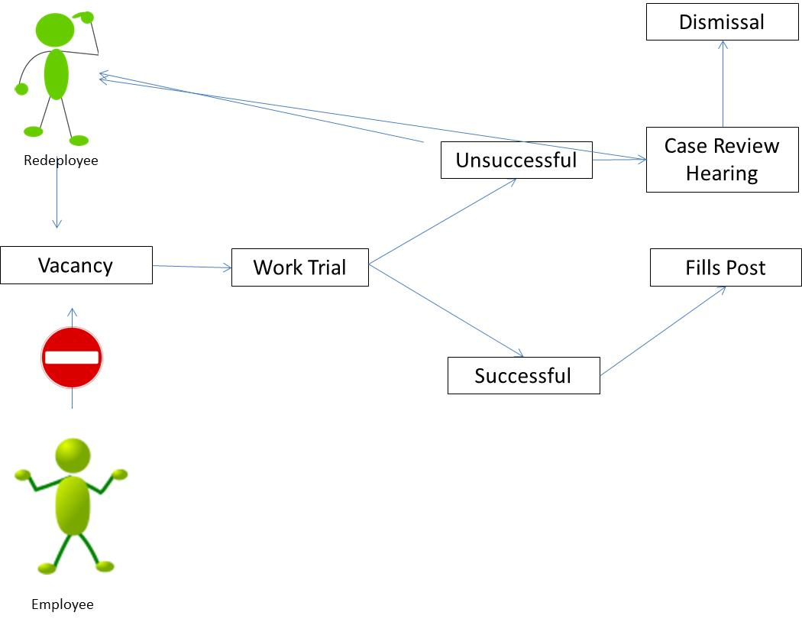
In Summary the Redeployee Process
People Centred
Positive
Compassion
Excellence
Notes:
This is a simple infographic of the process – remember, redeployees take priority over vacancies, they have the opportunity of a 4 week work trial, which can be extended if you want, they may have a maximum of up to 3 work trial opportunities before a Case Conference is undertaken, which may result in more opportunities to undertake further work trials to find a suitable redeployment or we could terminate with redundancy.
It is really important that you as Managers involved in the process play your part in:
Supporting Employee’s through the process
As a recruiting manager, look at redeployees first for any vacancies that you have and give them a fair trial with agreed objectives
Ensure you keep comprehensive notes of the actions that you have taken to support or reject a redeployee from posts

Slide 19
Templates
There are a number of templates to support the Recruiting
Manager with this process:
Action Plan / SMART Objectives
Feedback Form
People Centred
Positive
Compassion
Excellence
Notes:
Available through the oneHr Portal and within Redeployment Guidelines for Managers

Slide 20
Don’t forget HR will guide and support you every step of the way
People Centred
Positive
Compassion
Excellence

