Slide 1
Redeployment Process Guidance for Exporting Managers and Supervisors
People Centred
Positive
Compassion
Excellence

Slide 2
Steps
Understanding what Redeployment is
HR role in the process
Line management (exporting manager) responsibility
Individuals responsibility
The process
People Centred
Positive
Compassion
Excellence

Slide 3
1. What is Redeployment?
The placement of displaced staff into suitable alternative employment in the quickest possible time and to mitigate the need for redundancies and for dismissal on the grounds of capability.
People Centred
Positive
Compassion
Excellence
Notes:
This is the key to redeployment. It is all about finding staff who have been displaced from their current role and finding them a suitable alternative position in the organisation, thereby mitigating the need to make them redundant.
If you think about it logically, why would we let someone leave the organisation, that we have more than likely invested in, who more than likely has the skills and experience to move to another part of the organisation that is short of manpower?

Slide 4
When do you implement the process
Organisational Change
Capability / Performance Management
Capability / Ill Health
Each have individual Policies that MUST be followed
People Centred
Positive
Compassion
Excellence
Notes:
Organisational Change – In the current climate, the organisation is being asked to look at alternative work models and equipment and become more lean. Funding from CCG also has a major impact on the service we provide.
Performance Management – You would use this as a supportive tool, ultimately staff who are no longer able to fulfil their current role may be required to be placed on redeployment.
Ill Health – Again, staff whose health has deteriorated which has impacted on them being able to fulfil their current role
Please note that there are individual policies for each of these elements, with processes to follow
It is important to understand that each of the processes mentioned, do have their own individual policy and process that MUST be followed, but ultimately link to the redeployment process.

Slide 5
How do we make it successful?
There are 4 prongs to a successful redeployment:
Who | How
Exporting/Line Manager | Supportive to Individual
Recruiting Manager | Supportive to redeployees
HR | Support to individuals and Managers and ensuring a fair and robust process
Individual Employee | Proactive ownership of their own future
People Centred
Positive
Compassion
Excellence
Notes:
This is self-explanatory, but relies heavily on all four elements working together. If one element of this does not wholeheartedly support the process, then it isn’t going to work!
Line Manager – Perception that once on redeployment that it is no longer their responsibility
(In some circumstances e.g. Grievance against Line Manager, it may be necessary to allocate an alternative manager to support/manage the individual through this process)
Recruiting Manager – Need to ensure robust induction plan, 1 to 1 weekly meetings and training
HR – Perception is that it is ultimately our role to support all parties through a fair and robust process
Individual – They do not always take ownership as they are in a negative place “Why Me?”, “Why Should I?” but they do have responsibility to actively engage and be proactive

Slide 6
2. HR Role in the Process
Maintain an up to date Redeployment Register
Make exporting managers and employees aware of suitable vacancies
Ensure redeployees are given first priority for any vacancies
Provide relevant support to candidates in the use of NHS Jobs
Confirm offers of suitable work trials and successful redeployment
Support managers throughout and keep them fully briefed
People Centred
Positive
Compassion
Excellence
Notes:
HR are the link between all parties in this process and are there to support not only Managers, but the individual or individuals at risk. They will:
Maintaining an up to date Trust Redeployment or ‘At Risk’ Register (Redeployment Register)
Making employees on the Redeployment Register aware of suitable vacancies, where requested advising on interview preparation and arranging preferential interviews / matching meetings as appropriate
Ensuring that those on the Redeployment Register are given first priority for advertised jobs (See Section 3.2)
Where requested, providing relevant support to candidates in the use of NHS Jobs and in completing applications (Recruitment Dept.)
Confirming offers of suitable work trials and redeployment
Discussing with the Substantive Manager or Exporting Manager at the end of the redeployment period if no suitable posts have been found and what, if any, posts have been identified as suitable during the process and the actions taken

Slide 7
3. Exporting Manager Responsibility
Oversee the redeployment process until redeployment has been achieved or the individual has left the Trust by:
Conducting Aspirational Interview / Skills Assessment
Communication
Link with HR
Act as sponsor and referee for the employee
Bring any suitable alternative opportunities to the attention of the employee
Meet affected staff on a regular basis
People Centred
Positive
Compassion
Excellence
Notes:
It is really important that as a Line Manager or nominated manager you oversee the redeployment process until redeployment has been achieved or the individual has left the Trust. You need to see the whole redeployment process through from start to finish, irrespective of your own demands – remember, you are dealing with an individual who has potentially lost their job. So, how can you help:
• Ensure a full assessment of the skills, experience and availability of the affected employee (s) to work, so that an appropriate match with current vacancies can be made via an Aspirational Interview. (We will go through this in more detail at the end)
• Agree contact arrangements with the affected employee and support them in their search
• Advise their HR representative what suitable alternative duties or reasonable adjustments are required, as advised by Occupational Health (if redeployment is a result of ill health or disability)
• Act as sponsor and referee for the employee they wish to have redeployed, liaising with the potential recruiting manager as required
• Bring any suitable alternative opportunities to the attention of the employee
• Maintain regular contact with staff who are temporarily redeployed
• Meet staff on a regular basis where they are in receipt of pay protection, to review progress towards finding a post at the old grade.

Slide 8
4. Individuals Responsibilities
The employee must:
Be proactive in searching for suitable opportunities
Keep their substantive line manager updated
Prepare applications in a timely manner
They will be required to meet the performance and attendance standards of the new position.
People Centred
Positive
Compassion
Excellence
Notes:
Key to all of this is the Individual and as such, the Individual must:
• Be proactive in searching for suitable opportunities within the Trust and other accessible NHS organisations, recording their activity on a ‘Job Search Diary’ (See Appendix 2)
• Keeping their substantive line manager or nominated manager updated with posts they are considering
• Preparing applications in a timely manner seeking appropriate support if required and attend for interviews / matching meetings (or any other relevant selection activities)
Redeployment candidates will be required to meet the performance and attendance standards of the new position after a suitable period of induction and allowing for any reasonable adjustments that have been agreed
Remember, the individual will be going through all sorts of emotions, so it is really important that we treat them with Compassion and Care.

Slide 9
Support
Occupational Health – Counselling, CBT
Employee Assistance Programme (Health Assured)
Union
People Centred
Positive
Compassion
Excellence
Notes:
The individual will be going through all sorts of emotions, as alluded to earlier, they may be in a negative place asking “Why Me?”, “Why Should I?” It is really important that we treat them with Compassion and Care.
Support can be provided by a number of services available through the Trust:
Occupational Health - counselling or CBT.
Employee Assistance Programme – this offers a vast number of services from financial information, medical information, counselling available and all calls are answered by a qualified counsellor who will offer help and support in a professional, friendly and non-judgmental manner. Stress & anxiety.
Union – if an employee is with a recognisable professional body then to engage with the Union from the very beginning will provide the employee with support. Union will assist them with what is expected from the process and relevant risks.

Slide 10
5. The Principles of the Process
The responsibility for ensuring successful redeployment rests with all parties.
Costs - e.g. pay protection, new training etc. will be borne by the Exporting department
Suitable alternative vacancies - preferential interview status to the candidate
Redeployee will be granted a minimum of a 4 week work trial period.
Ill Health / Disability - Managers should take into account any reasonable adjustments.
Re-Organisation – Redeployees will be expected to make themselves available for any short term or temporary posts.
Forfeiture of rights to redundancy pay or pay protection
People Centred
Positive
Compassion
Excellence
Notes:
Key to a successful redeployment is that the responsibility for ensuring successful redeployment rests with all parties. I cannot stress how important collaboration by all involved is to making this a success. To support this, a set of robust principles have been agreed:
• Any additional costs arising from the redeployment e.g. pay protection, new training etc. will be borne by the Exporting department
• Full financial responsibility for the displaced member of staff will rest with the Exporting department until successful redeployment
• Departments with suitable alternative vacancies for which the individual is qualified will be required to give preferential interview status to the candidate
• Staff will be granted a minimum of a 4 week work trial period. The four week trial period can be extended by agreement by a further 2 weeks unless it can be justified, for example to attend training, for this to be increased further.
• Redeployment candidates will be required to meet the performance and attendance standards of the new position after a suitable period of induction and allowing for any adjustments that have been agreed. (Measurable objectives)
• Managers should take into account any appropriate medical advice with regard to reasonable adjustments required or suitable duties for staff being redeployed for reason of ill health or disability.
• Candidates who are on the redeployment register because of organisational change will be expected to make themselves available for any short term or temporary posts for which they are suitable whilst waiting for a permanent post to arise.
• Candidates who do not make reasonable efforts to secure suitable alternative employment may forfeit their entitlement to redundancy pay or pay protection, if appropriate. Especially if the Exporting Manager deems the role to be a suitable alternative in accordance with the Aspirational Interview Form.
Redeployment for Performance Management or Capability Grounds are not entitled to Pay Protection.

Slide 11
The Process
All vacancies will be subject to review by HR prior to being uploaded on the recruitment site (TRAC)
Posts identified as potential redeployment opportunity will be taken out of the recruitment process until redeployment has been fully explored.
People Centred
Positive
Compassion
Excellence
Notes:
This is a key element in the Process and one that you need to be aware of. If you are a Manager of a Department that wants to launch a recruitment campaign, remember, we will review it and if we believe there is a Redeployment Opportunity for someone at risk of redundancy, it will be explored as a potential solution for those in the redeployment pool before you can formally advertise.

Slide 12
Exporting Manager
Employee will be assessed as being suitable for a vacancy if they meet the essential criteria on the person specification.
Reasonable training and adjustments where the employee is considered to have a Disability in accordance with the Equality Act 2010
Where redeployment is on medical grounds medical advice should be sought through Occupational Health .
People Centred
Positive
Compassion
Excellence
Notes:
To achieve a successful redeployment, we must be conscious of current legislation in terms of the Equality Act 2010. So you really do need to be aware of your responsibilities in this area and the advice and guidance that Occupational Health and HR can provide.
Staff on the redeployment register will be assessed as being suitable for a vacancy if the employee meets the essential criteria on the person specification, allowing for reasonable training and also reasonable adjustments where the employee is considered to have a Disability in accordance with the Equality Act 2010
The process of redeployment on Medical Grounds will only commence once guidance and support is received from Occupational Health

Slide 13
Exporting Manager
When suitable post identified (agreed by both Manager and HR), the employee will be asked to contact and arrange a meeting with the Recruiting Manager with a view to starting a work trial.
Completed Aspirational Interview Form to be provided to Recruiting Manager
Redeployment opportunities will be sought at the employee’s substantive pay band. However, as an alternative, posts at different pay bands maybe considered.
People Centred
Positive
Compassion
Excellence
Notes:
Work Trials are an important element of redeployment and give both the Individual and the Recruiting Manager the opportunity to get a flavour for how the individual is coping in a new role but also how the individual is made to feel in joining a new team and filling a new role. If an employee who is undergoing a work trial has an enjoyable experience, they are more likely to stay and be a productive member of your team.
Redeployment opportunities will be sought at the employee’s substantive pay band. As an alternative posts of a different pay band (one higher and one lower) may be considered. However, if it is at a lower band then pay protection will need to be taken into account. The Trust’s Pay Protection Policy provided details of entitlement. Don’t forget, this would not apply to those under the Performance Management or Ill Health process.
A copy of the completed aspirational interview form must be provided to the recruiting manager in order that this may then be discussed with the redeployee.

Slide 14
Exporting Manager
Once a work trial has commenced, if the employee or the recruiting manager deem the trial NOT to be working then the employee WILL return to their substantive department.
Redeployment process continues for the remainder of the 12-week period.
People Centred
Positive
Compassion
Excellence
Notes:
On occasion it may be deemed by both the employee and the recruiting manager that the trial is not working (this can be for a number of reasons) and evidence as to why it is not working will be provided in the format of the Feedback Forms for Manager and Feedback Forms for Employee.
The employee is entitled at this point to return to their substantive department as soon as feasibly possible, where the Line Manager will then provide support with the continued redeployment process
It is NOT the responsibility of the recruiting manager to find the employee alternative redeployment

Slide 15
Exporting Manager
SUITABLE ALTERNATIVE
Following a period of 12 weeks, or earlier if agreed, from the date of being placed on the redeployment register, and no suitable alternative has been secured, a review hearing must be arranged in all instances with a panel, HR, the Line Manager and employee. In cases of Disability this period may be extended as a reasonable adjustment.
Employees will be invited to the review hearing, accompanied if they wish, by a trade union representative or a work colleague. The Exporting manager who holds the substantive post will lead the discussion and each case will be assessed on its merits, with the aim of reviewing the options available. At this meeting, consideration will be given to termination of employment, the grounds of which will form part of the discussion.
People Centred
Positive
Compassion
Excellence
Notes:
This is a critical point and it is vital that as managers involved in this, that you have kept comprehensive notes of all stages of the process as to why an individual has exhausted the opportunities presented to them. This will help to determine whether the Trust extends the time given to an individual to be redeployed or does look at making them redundant.
It is worth noting, if termination is deemed the next stage, this will be presented in the format of a MSOC to a panel consisting of the Head of Service (who has dismissal rights), Senior HR support (Manager or HRBP), the Exporting Manager and the HR Advisor/Manager who has been supporting the process. It is also likely that a note taker will be present.

Slide 16
Exporting Manager
TIMESCALES
Scenario 1 | Week 1 | Week 4 | Week 8 | Week 10 | Week 12
No Suitable Vacancy available | Placed on Register following Aspirational Interview completion via Manager | 4 Week Review Meeting | 8 Week Review Meeting | Advise Employee @ 12 Weeks Case Hearing where Redundancy or Dismissal may be agreed | Attend Hearing Outcome possible extended redeployment period OR redundant
People Centred
Positive
Compassion
Excellence

Slide 17
Exporting Manager
TIMESCALES
Scenario 2 | Week 1 | Week 2 | Week 4 | Week 6 | Week 4 or 6
Suitable Vacancy Available but unsuccessful work trial | Placed on Register following Aspirational Interview completed via Manager Suitable vacancy secured | Work Trial commence | Feedback / confirmation sought as to whether trial successful or not. Work Trial unsuccessful and letter confirming placed back on register – Return to substantive Division | Deviation of timescales possible of further 2 weeks if trial needed to be extended | The process is repeated if further opportunities arise (up to a maximum of 3 trials in total)
People Centred
Positive
Compassion
Excellence

Slide 18
Exporting Manager
TIMESCALES
Scenario 3 | Week 1 | Week 2 | Week 4 | Week 4 - 6 | Week 4 or 6
Suitable Vacancy available – successful | Placed on Register following Aspirational Interview completed via Manager. Suitable Vacancy secured | Work Trial commence | Feedback / Confirmation sought as to whether trial successful or not. Work Trial successful letter confirming substantive redeployment | Deviation of timescale possible of further 2 weeks if trial needed to be extended. Work Trial successful letter confirming substantive redeployment | Assignment Change Form MUST be completed and personal file transferred
People Centred
Positive
Compassion
Excellence

Slide 19
Exporting Manager
TIMESCALES
Scenario 4 | Week 1 | Week 2 | Week 6 - 8 | Week 8 - 12 | Week 4 or 6
Suitable Vacancy found but rejected | Placed on Register following Aspirational Interview completed by Line Manager Work trial offered Confirmation of rejection and reason received. Discussion with Management and deemed suitable | Meeting held and member of staff advises deemed suitable and will be required to attend Hearing, where employment terminated WITHOUT redundancy. Hearing date to be secured MSOC drafted – this can take up to 6 weeks to be secured and MSOC drafted | Hearing held Right to Appeal (2 weeks) | Appeal Hearing | Both securing the initial hearing and / or appeal hearing can take longer depending on Senior Management availability
People Centred
Positive
Compassion
Excellence

Slide 20
Successful Work Trial
Individual integrated into the team and made to feel part of the team
Clear objectives that have been met
Supportive Manager, giving/providing regular feedback (Weekly 1:1’s for example)
If there are adjustments that have to be made (OH etc), then don’t allow them to hinder the individuals work trial – support them
Assignment Change Form completed and personal file transferred to recruiting manager.
People Centred
Positive
Compassion
Excellence

Slide 21
Unsuccessful Work Trial – Why!
Unclear or undocumented objectives
No adjustments being made for any OH measures
Little to no engagement with the individual
No feedback on performance issues
Grievance by the individual
People Centred
Positive
Compassion
Excellence

Slide 22
Employee
Employees may undertake up to a maximum of 3 work trials. If an employee rejects a work trial without a justifiable reason, that would count as one work trial for the purpose of this process.
If an employee rejects the offer of a post deemed to be an appropriate job match without a justifiable reason, the employee may forfeit their right to a redundancy payment, where applicable.
People Centred
Positive
Compassion
Excellence
Notes:
In an effort to try and redeploy people affected by Organisational change etc, they have up to 3 opportunities to try and find the right job. If they reject a work trial without a justifiable reason, that would count as one work trial and they would forfeit one of those chances. Again, it is important that you document the reasons.
Employees need to be aware of this as it could have a significant impact on their financial expectations. Our aim is not to make them redundant, but try and find them a suitable opportunity. As we have said earlier, they too have an obligation to support the process, so we should try to understand (and document) why they are rejecting the post.

Slide 23
Employee
Redeployment on fewer hours and pay protection being received, the staff member will be required to work their original hours until the time limited period of protection ceases (Organisation Change only)
People Centred
Positive
Compassion
Excellence
Notes:
Just because the job is advertised as fewer hours, there will be an expectation that they work the number of hours that they are originally contracted for, as we will be giving them protected pay.
If an employee is redeployed to a post of fewer hours than they are currently contracted for, and therefore receive pay protection in accordance with the Trusts Protection of Pay Policy, they must work their original hours until the time limited period of protection ceases, with the additional cost being met by the Exporting department.
This only applies to those under the Organisational Change process

Slide 24
Process – Final Stage
In all cases it is both the Recruiting Manager and Exporting Managers’ responsibility to notify the employee of the outcome of any trial (successful or not)
Arrange the necessary paperwork including an assignment change form and agree set objectives and a personal development plan for the next 12 months.
People Centred
Positive
Compassion
Excellence
Notes:
If they are successful, both substantive and gaining Manager will be required to complete all necessary assignment change forms and transfer Personal File

Slide 25
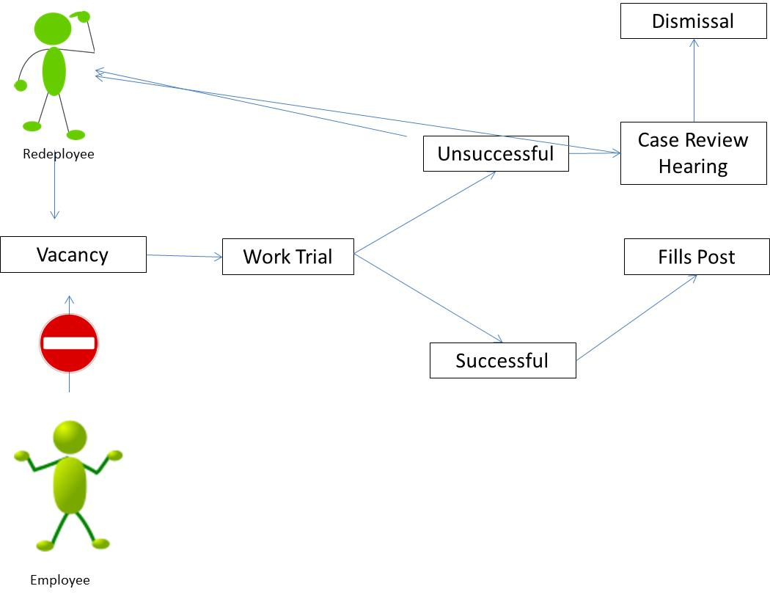
In Summary the Redeployee Process
People Centred
Positive
Compassion
Excellence
Notes:
This is a simple infographic of the process – remember, redeployees take priority over vacancies, they have the opportunity of a 4 week work trial, which can be extended if you want, they may have a maximum of up to 3 work trial opportunities before a Case Conference is undertaken, which may result in more opportunities to undertake further work trials to find a suitable redeployment or we could terminate with redundancy.
It is really important that you as Managers involved in the process play your part in:
Supporting Employee’s through the process
As a recruiting manager, look at redeployees first for any vacancies that you have and give them a fair trial with agreed objectives
Ensure you keep comprehensive notes of the actions that you have taken to support or reject a redeployee from posts

Slide 26
Templates
There are a number of templates on the OneHR Portal
To support Exporting
Managers with this process:
At Risk - Invite to Aspirational Interview
Aspirational Interview Form
Job Search / Offer Form (both manager and employees)
4 week Work Trial Letter
Unsuccessful Work Trial letter
Successful Work Trial letter
Suitable Alternative but declined letter
People Centred
Positive
Compassion
Excellence

Slide 27
Don’t forget HR will guide and support you every step of the way
People Centred
Positive
Compassion
Excellence

